Slide 1
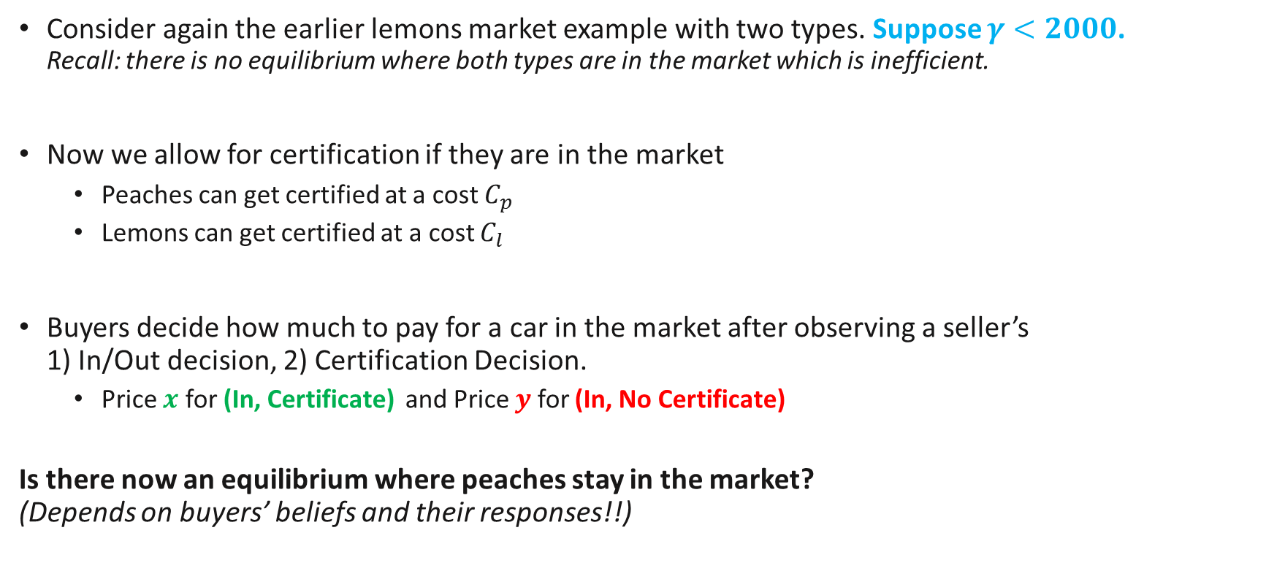
Lemons Market Signalling
Consider again the earlier lemons market example with two types. Suppose $γ<2000$. Recall: there is no equilibrium where both types are in the market which is inefficient.
Now we allow for certification if they are in the market
Peaches can get certified at a cost $C_{p}$
Lemons can get certified at a cost $C_{l}$
Buyers decide how much to pay for a car in the market after observing a seller’s 1) In/Out decision, 2) Certification Decision.
Price $x$ for (In, Certificate) and Price $y$ for (In, No Certificate)
Is there now an equilibrium where peaches stay in the market? (Depends on buyers’ beliefs and their responses!!)
Notes:
They only observe cars in the market and whether they have certification or not.

Slide 2
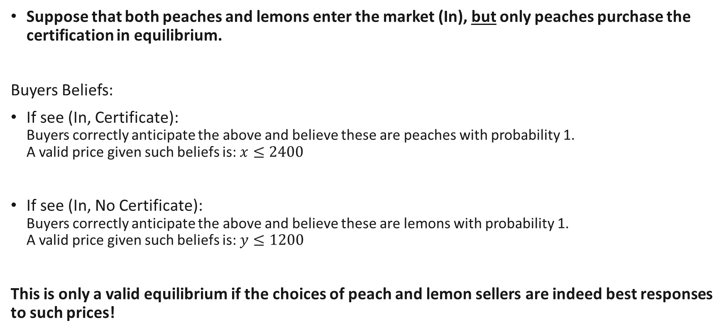
Separating Equilibrium (with signalling)
Suppose that both peaches and lemons enter the market (In), but only peaches purchase the certification in equilibrium.
Buyers Beliefs:
If see (In, Certificate): Buyers correctly anticipate the above and believe these are peaches with probability 1. A valid price given such beliefs is: $x≤2400$
If see (In, No Certificate): Buyers correctly anticipate the above and believe these are lemons with probability 1. A valid price given such beliefs is: $y≤1200$
This is only a valid equilibrium if the choices of peach and lemon sellers are indeed best responses to such prices!
Price lower than buyers’ valuations

Slide 3
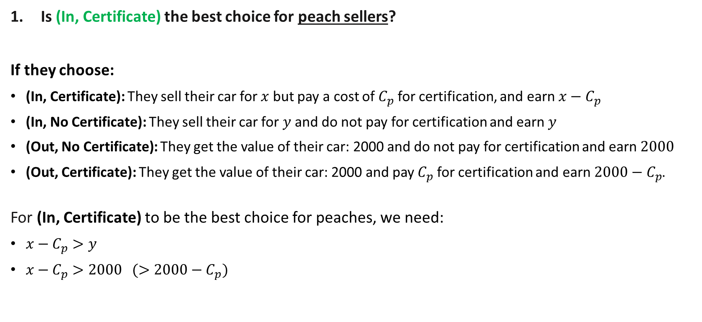
Separating Equilibrium (Peaches choices)
Is (In, Certificate) the best choice for peach sellers?
If they choose:
(In, Certificate): They sell their car for $x$ but pay a cost of $C_{p}$ for certification, and earn $x−C_{p}$
(In, No Certificate): They sell their car for $y$ and do not pay for certification and earn $y$
(Out, No Certificate): They get the value of their car: 2000 and do not pay for certification and earn $2000$
(Out, Certificate): They get the value of their car: 2000 and pay $C_{p}$ for certification and earn $2000−C_{p}$.
For (In, Certificate) to be the best choice for peaches, we need:
$x−C_{p}>y$
$x−C_{p}>2000 (>2000−C_{p})$
Notes:
An example which works is if $C_{p}=100$, $C_{l}=900$
$x=2200$, $y=$1400

Slide 4
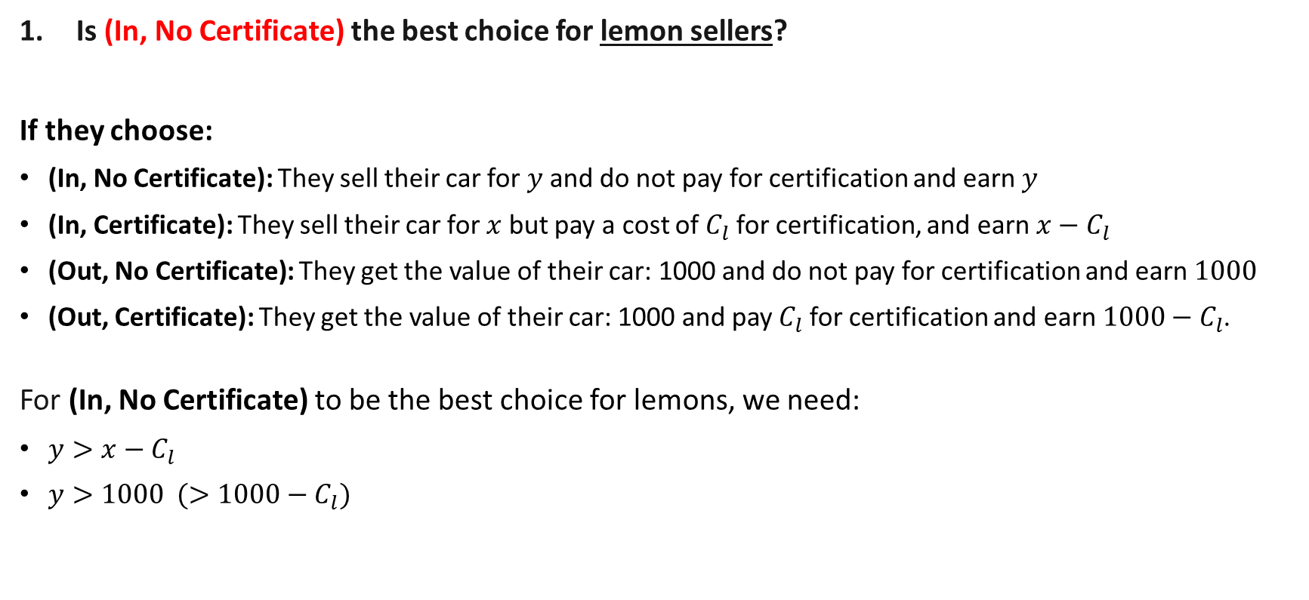
Separating Equilibrium (Lemons’ choices)
Is (In, No Certificate) the best choice for lemon sellers?
If they choose:
(In, No Certificate): They sell their car for $y$ and do not pay for certification and earn $y$
(In, Certificate): They sell their car for $x$ but pay a cost of $C_{l}$ for certification, and earn $x−C_{l}$
(Out, No Certificate): They get the value of their car: 1000 and do not pay for certification and earn $1000$
(Out, Certificate): They get the value of their car: 1000 and pay $C_{l}$ for certification and earn $1000−C_{l}$.
For (In, No Certificate) to be the best choice for lemons, we need:
$y>x−C_{l}$
$y>1000 (>1000−C_{l})$
Notes:
An example which works is if $C_{p}=100$, $C_{l}=900$
$x=2200$, $y=$1400

Slide 5
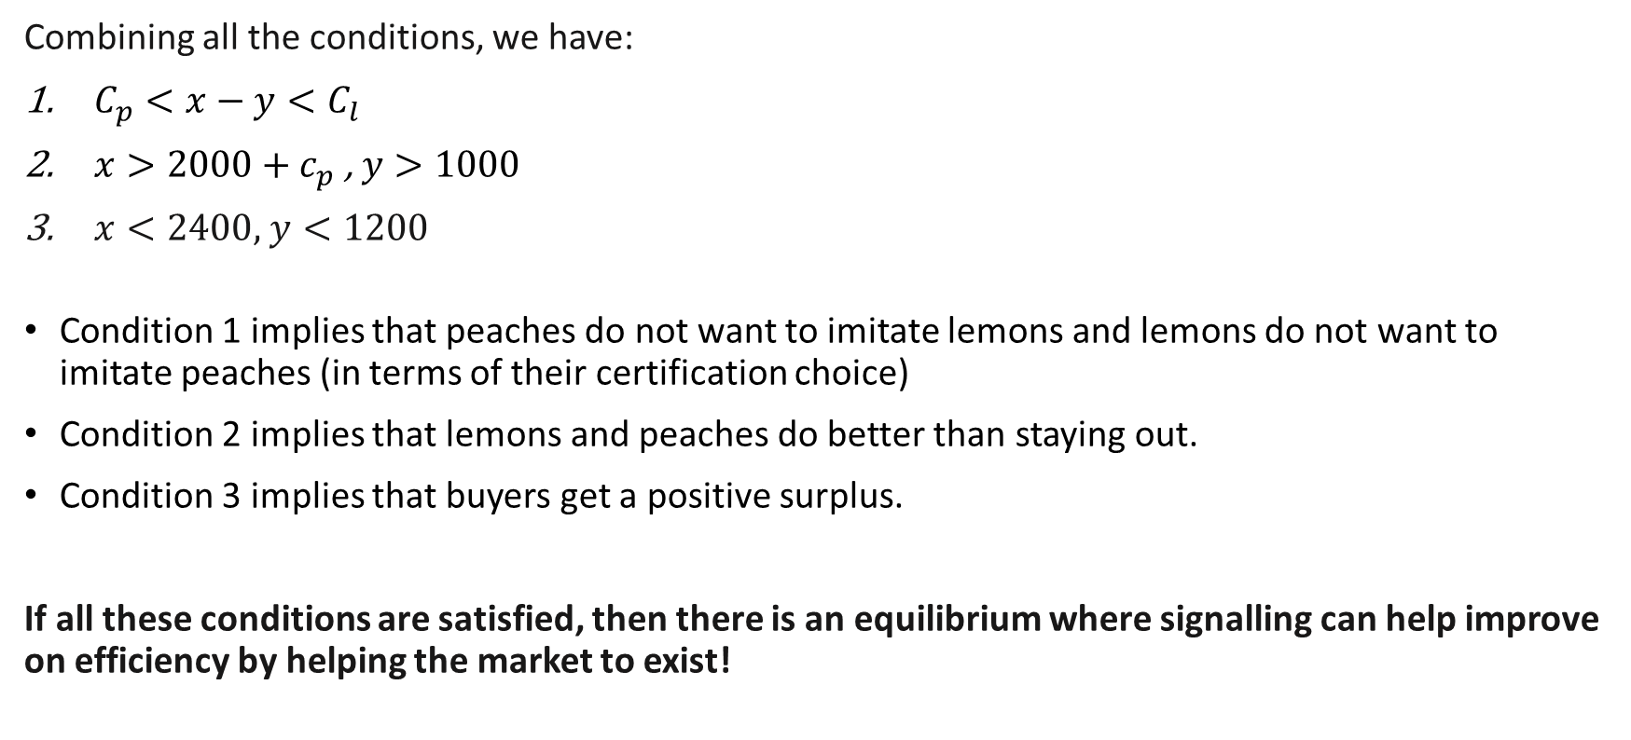
Separating Equilibrium (with signalling)
Combining all the conditions, we have:
$C_{p}<x−y<C_{l}$
$x>2000+c_{p}$ , $y>1000$
$x<2400,$ $y<1200$
Condition 1 implies that peaches do not want to imitate lemons and lemons do not want to imitate peaches (in terms of their certification choice)
Condition 2 implies that lemons and peaches do better than staying out.
Condition 3 implies that buyers get a positive surplus.
If all these conditions are satisfied, then there is an equilibrium where signalling can help improve on efficiency by helping the market to exist!
Notes:
An example which works is if $C_{p}=100$, $C_{l}=900$
$x=2200$, $y=$1400

Slide 6
Aside: Beliefs on the equilibrium path.
Recall that buyers only observe 1) sellers who enter, 2) whether they have a certificate.
They form beliefs about sellers depending on these observations which influences their expected value. Two potential observations: (In, Certificate) & (In, No Certificate)
How do we determine their beliefs? We assume that in equilibrium, they anticipate seller’s strategies correctly!
Separating Equilibrium
Peaches
(In, Certificate)
Lemons: (In, No Certificate)
Strategy
Belief
Strategy
Belief
Because peaches are the only ones who choose (In, Certificate), in equilibrium, they believe that an observation of (In, Certificate) implies a Peach
Because lemons are the only ones who choose (In, No Certificate), in equilibrium, they believe that an observation of (In, No Certificate) implies a Lemon

Slide 7
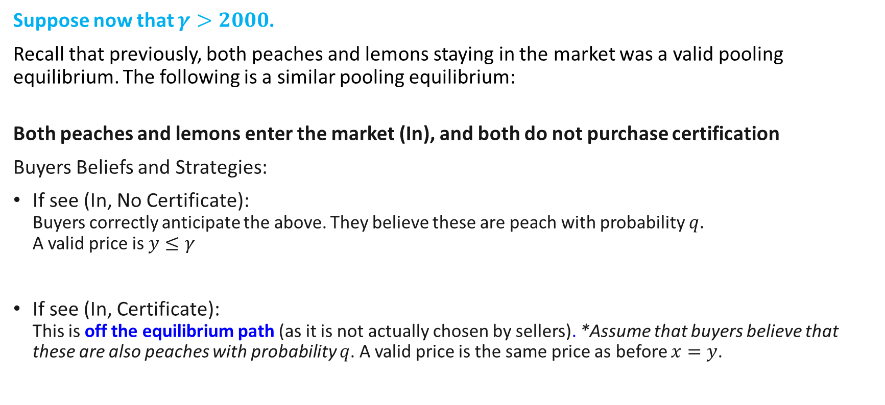
Pooling Equilibrium 1 (with signalling)
Suppose now that $γ>2000$.
Recall that previously, both peaches and lemons staying in the market was a valid pooling equilibrium. The following is a similar pooling equilibrium:
Both peaches and lemons enter the market (In), and both do not purchase certification
Buyers Beliefs and Strategies:
If see (In, No Certificate): Buyers correctly anticipate the above. They believe these are peach with probability $q.$ A valid price is $y≤γ$
If see (In, Certificate): This is off the equilibrium path (as it is not actually chosen by sellers). *Assume that buyers believe that these are also peaches with probability $q$. A valid price is the same price as before $x=y$.

Slide 8

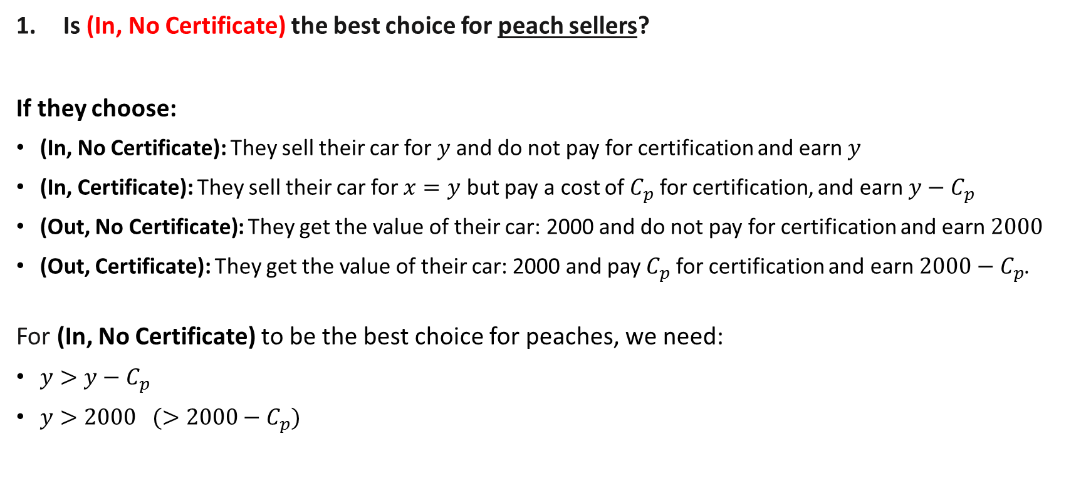
Pooling Equilibrium 1 (Peaches Choices)
Is (In, No Certificate) the best choice for peach sellers?
If they choose:
(In, No Certificate): They sell their car for $y$ and do not pay for certification and earn $y$
(In, Certificate): They sell their car for $x=y$ but pay a cost of $C_{p}$ for certification, and earn $y−C_{p}$
(Out, No Certificate): They get the value of their car: 2000 and do not pay for certification and earn $2000$
(Out, Certificate): They get the value of their car: 2000 and pay $C_{p}$ for certification and earn $2000−C_{p}$.
For (In, No Certificate) to be the best choice for peaches, we need:
$y>y−C_{p}$
$y>2000 (>2000−C_{p})$

Slide 9
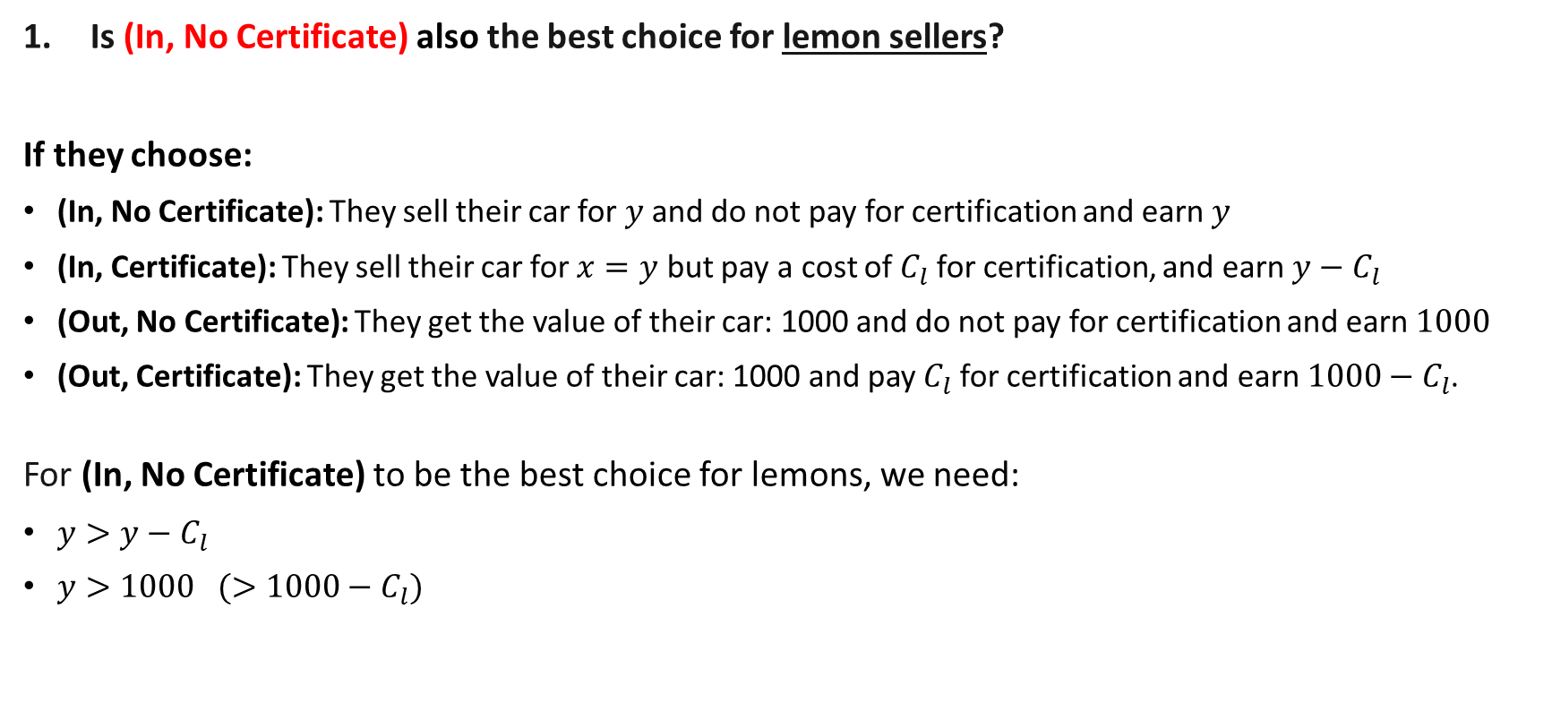
Pooling Equilibrium 1 (Lemons’ Choices)
Is (In, No Certificate) also the best choice for lemon sellers?
If they choose:
(In, No Certificate): They sell their car for $y$ and do not pay for certification and earn $y$
(In, Certificate): They sell their car for $x=y$ but pay a cost of $C_{l}$ for certification, and earn $y−C_{l}$
(Out, No Certificate): They get the value of their car: 1000 and do not pay for certification and earn $1000$
(Out, Certificate): They get the value of their car: 1000 and pay $C_{l}$ for certification and earn $1000−C_{l}$.
For (In, No Certificate) to be the best choice for lemons, we need:
$y>y−C_{l}$
$y>1000 (>1000−C_{l})$

Slide 10
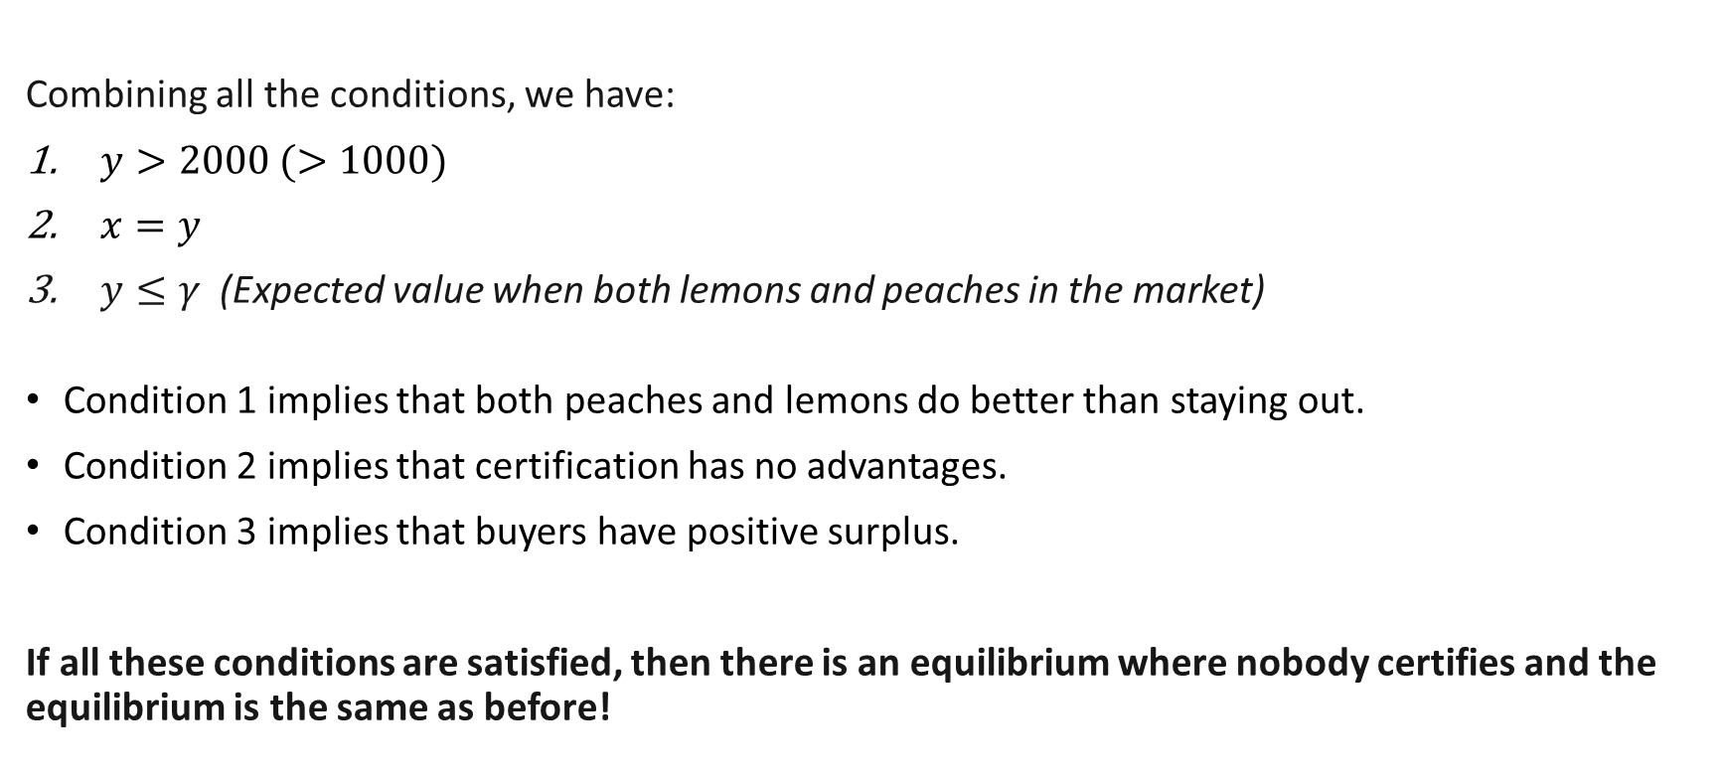
Pooling Equilibrium 1 (with signalling)
Combining all the conditions, we have:
$y>2000 (>1000)$
$x=y$
$y≤γ$ (Expected value when both lemons and peaches in the market)
Condition 1 implies that both peaches and lemons do better than staying out.
Condition 2 implies that certification has no advantages.
Condition 3 implies that buyers have positive surplus.
If all these conditions are satisfied, then there is an equilibrium where nobody certifies and the equilibrium is the same as before!
Notes:
An example which works is if $C_{p}=100$, $C_{l}=900$
$x=2200$, $y=$1400

Slide 11
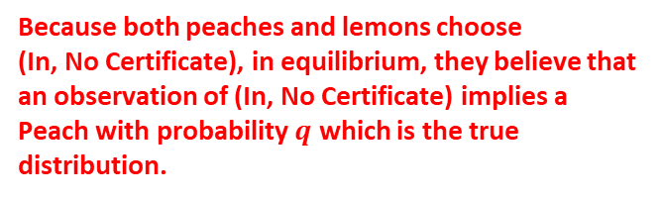
Aside: Beliefs on/off the equilibrium path.
Recall that buyers only observe 1) sellers who enter, 2) whether they have a certificate.
They form beliefs about sellers depending on these observations which influences their expected value. Two potential observations: (In, Certificate) & (In, No Certificate)
How do we determine their beliefs? We assume that in equilibrium, they anticipate seller’s strategies correctly!
Pooling Equilibrium 1
Peaches & Lemons:
(In, No Certificate)
(In, Certificate)
Strategy
Belief
Belief???
Because both peaches and lemons choose (In, No Certificate), in equilibrium, they believe that an observation of (In, No Certificate) implies a Peach with probability $q$ which is the true distribution.
What should they think about a strategy that is not chosen in equilibrium?
No correct belief, so we assume that they can believe anything!*

Slide 12
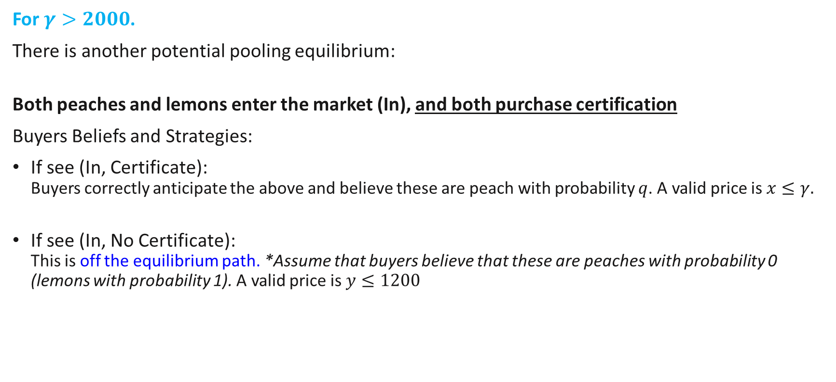
Pooling Equilibrium 2 (with signalling)
For $γ>2000$.
There is another potential pooling equilibrium:
Both peaches and lemons enter the market (In), and both purchase certification
Buyers Beliefs and Strategies:
If see (In, Certificate): Buyers correctly anticipate the above and believe these are peach with probability $q$. A valid price is $x≤γ.$
If see (In, No Certificate): This is off the equilibrium path. *Assume that buyers believe that these are peaches with probability 0 (lemons with probability 1). A valid price is $y≤1200$

Slide 13
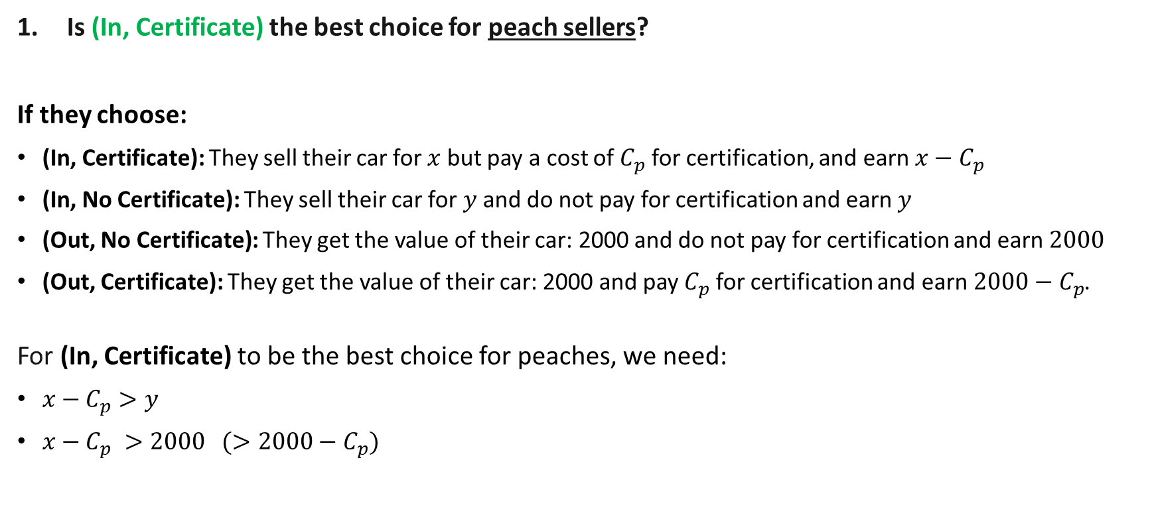
Pooling Equilibrium 2 (with signalling)
Is (In, Certificate) the best choice for peach sellers?
If they choose:
(In, Certificate): They sell their car for $x$ but pay a cost of $C_{p}$ for certification, and earn $x−C_{p}$
(In, No Certificate): They sell their car for $y$ and do not pay for certification and earn $y$
(Out, No Certificate): They get the value of their car: 2000 and do not pay for certification and earn $2000$
(Out, Certificate): They get the value of their car: 2000 and pay $C_{p}$ for certification and earn $2000−C_{p}$.
For (In, Certificate) to be the best choice for peaches, we need:
$x−C_{p}>y$
$x−C_{p} >2000 (>2000−C_{p})$

Slide 14
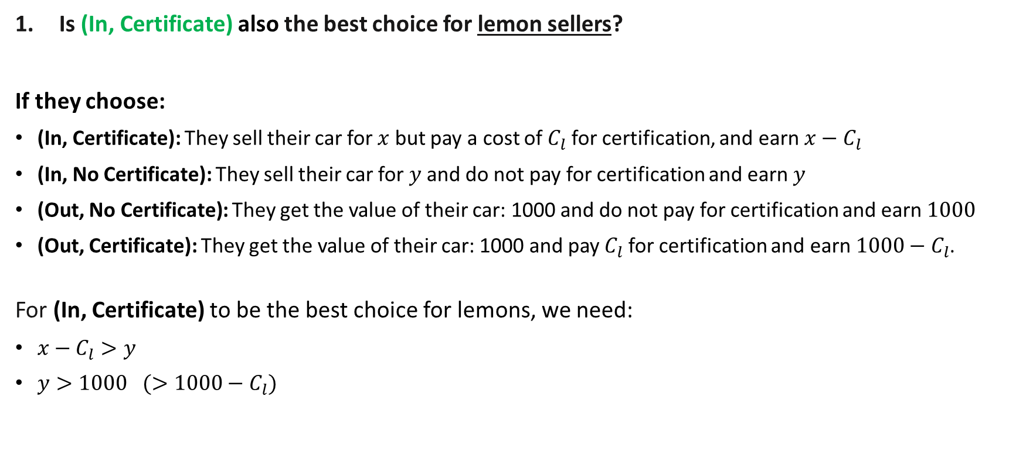
Pooling Equilibrium 2 (with signalling)
Is (In, Certificate) also the best choice for lemon sellers?
If they choose:
(In, Certificate): They sell their car for $x$ but pay a cost of $C_{l}$ for certification, and earn $x−C_{l}$
(In, No Certificate): They sell their car for $y$ and do not pay for certification and earn $y$
(Out, No Certificate): They get the value of their car: 1000 and do not pay for certification and earn $1000$
(Out, Certificate): They get the value of their car: 1000 and pay $C_{l}$ for certification and earn $1000−C_{l}$.
For (In, Certificate) to be the best choice for lemons, we need:
$x−C_{l}>y$
$y>1000 (>1000−C_{l})$

Slide 15
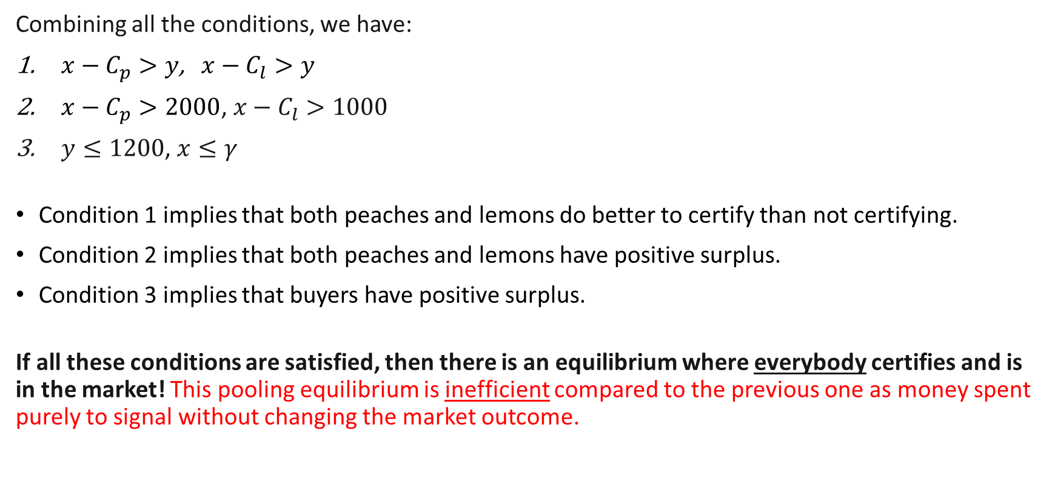
Pooling Equilibrium 2 (with signalling)
Combining all the conditions, we have:
$x−C_{p}>y$, $x−C_{l}>y$
$x−C_{p}>2000$, $x−C_{l}>1000$
$y≤1200$, $x≤γ$
Condition 1 implies that both peaches and lemons do better to certify than not certifying.
Condition 2 implies that both peaches and lemons have positive surplus.
Condition 3 implies that buyers have positive surplus.
If all these conditions are satisfied, then there is an equilibrium where everybody certifies and is in the market! This pooling equilibrium is inefficient compared to the previous one as money spent purely to signal without changing the market outcome.
(Can be satisfied when certification costs are not too high)
When information is not important for market efficiency, signalling might not always beneficial as it might lead to a rat race…

Slide 16

General steps for Signalling Equilibria
Suppose there are two types of first movers: $i$ and $j$
In a scenario where second mover has incomplete information about the first mover and we are checking whether there is an equilibrium where first movers do $X_{i},X_{j}$
Consider the strategies $X_{i},X_{j}$.
Assume that the second mover has correct beliefs about what each type will do.
If there is no “correct belief”, any belief can be specified.
Get the second mover’s best responses.
Given the second mover’s best response, check whether it is possible for $X_{i}$ and $X_{j}$ to be best responses for the first mover types.

